Slide 1
Dynamic Programming
Part 2

Slide 2
We saw Coin Change Problems last time, they are in fact a variant of a more general class of problems called Knapsack.
General Knapsack Problem:
Given n objects, i-th object has weight w[i] and cost c[i], output maximum cost you can get for some objects with total weight <= W.
Example:
6 objects, weights : 2, 7, 8, 5, 1, 2 and costs 2, 1, 2, 1, 2, 1 and maximum weight 9.
The optimal way is to take 1st, 4th and 5th object, weight = 8, cost = 5.
This has two solutions.

Slide 3
O(nW) solution:
After processing n objects, suppose we have some optimal cost. What do we need to remember?
We need to remember what weight we have already used.
So define
dp[i][x] = optimal cost acquired after looking at first i objects and picking objects of x weight.
The transition is
dp[i][x] = max(dp[i-1][x], dp[i-1][x-w[i] ]+c[i])
Answer is max of all dp[n][x] with x <= W.

Slide 4
O(nC) solution (C = sum of all cost):
Let’s shift our perspective, instead of fixing weight and keeping optimal cost, let’s fix cost and look for optimal weight
So define
dp[i][p] = minimum total weight for choosing some objects from first i objects, where chosen objects have total cost p.
The transition is
dp[i][p] = max(dp[i-1][p], dp[i-1][p-c[i] ]+w[i])
Answer is max p such that dp[n][p] <= W
So, sometimes our answer is not even a dp value!

Slide 5
A common variation of Knapsack: Given n weights, output all possible distinct sums.
Solution:
There is no optimal cost or count of ways here, how do we perform DP?
The DP is a boolean DP.
We define,
dp[i][x] = true/false according to whether x is a possible sum of sum elements from first i weights
Transition:
dp[i][x] = dp[i-1][x] || dp[i-1][x-w[i]]
Note that base case is dp[i][0] = true

Slide 6
Last problem can be made faster 32 times using bitset.
In fact we can define,
dp[i] = a bitset who’s j-th elemnt is 1 iff j can be made using first i elements
The transition is,
dp[i] = dp[i-1] || (dp[i-1]<<w[i])
The complexity isn’t better, but sometimes constraints are set so that we need to use this speedup.

Slide 7
Problem Line of Wines: There are n wines in a row, i-th wine has initial price w[i], you will sell either the leftmost wine or the rightmost wine at each step. The k-th sold wine will be sold for k * w[i]. What is the maximum price you can get?
Example: There are 5 wines, the costs are: 2 4 6 2 5
The optimal path is sell the wines in this order = 1st, 5th, 4th, 2nd, 3rd and you will get total price = 1 * 2 + 2 * 5 + 3 * 2 + 4 * 4 + 5 * 6 = 64

Slide 8
Problem Line of Wines: There are n wines in a row, i-th wine has initial price w[i], you will sell either the leftmost wine or the rightmost wine at each step. The k-th sold wine will be sold for k * w[i]. What is the maximum price you can get?
Solution O(n²):
We note that after some wines are sold, we’re always left with some subarray of original array. So we can define
dp[l][r][i] = maximum total price we can get if remaining subarray is [l, r] and i wines are already sold.
But i is redundant!
i is always n – (r – l +1).
So state is only dp[l][r].
dp[l][r] = max((i+1) * w[l] + dp[l+1][r], (i+1)*w[r] + dp[l][r-1])

Slide 9
Problem Line of Wines: There are n wines in a row, i-th wine has initial price w[i], you will sell either the leftmost wine or the rightmost wine at each step. The k-th sold wine will be sold for k * w[i]. What is the maximum price you can get?
Alternative Solution O(n²):
Again we solve for dp[l][r], but this time we solve the problem for each subarray i.e.
dp[l][r] = answer we’ll get if we start with the [l,r] subarray
For this the transition is
dp[l][r] = max(dp[l+1][r] + sum(l+1, r), dp[l][r-1] + sum(l, r-1))
Note that in this solution we need to precompute prefix sums to efficiently query sum(l, r)

Slide 10
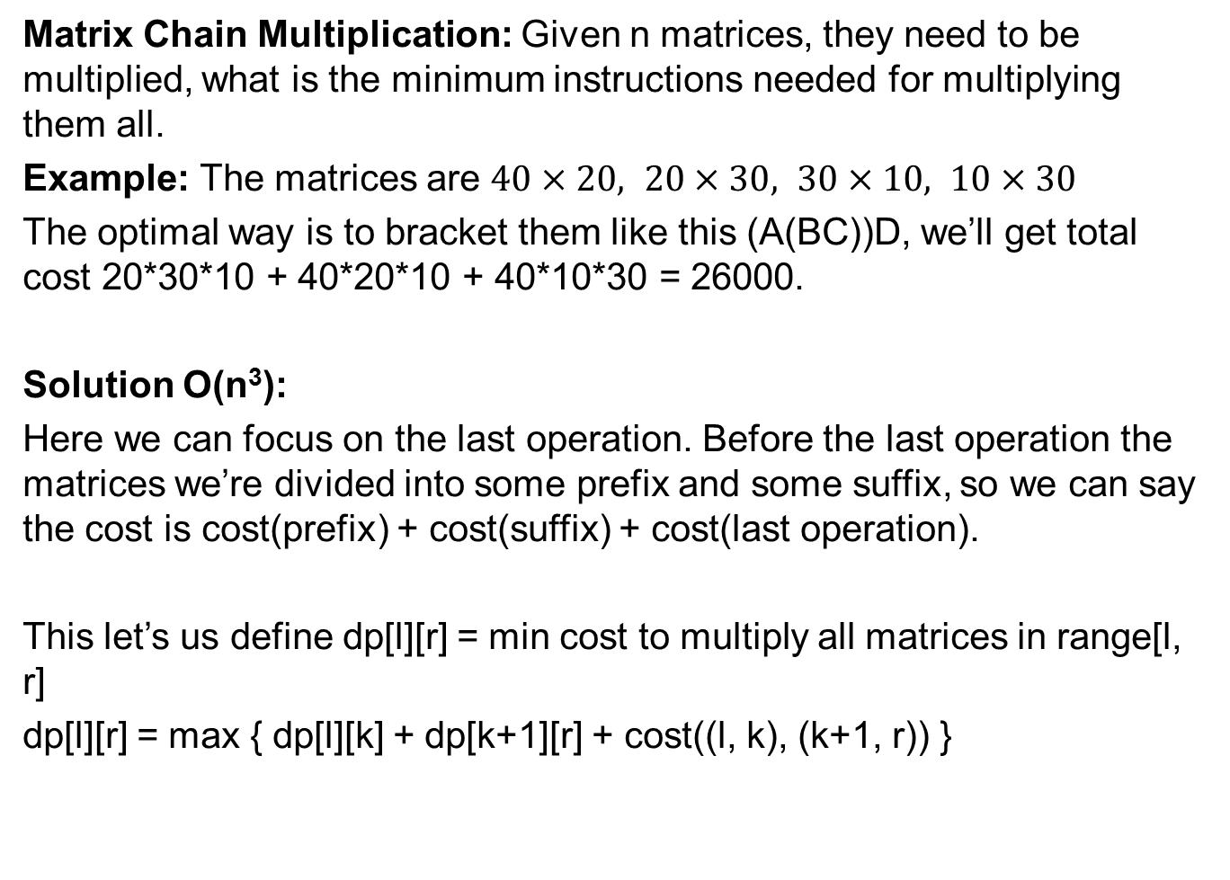
Matrix Chain Multiplication: Given n matrices, they need to be multiplied, what is the minimum instructions needed for multiplying them all.
Example: The matrices are $40×20, 20×30, 30×10, 10×30$
The optimal way is to bracket them like this (A(BC))D, we’ll get total cost 20*30*10 + 40*20*10 + 40*10*30 = 26000.
Solution O(n³):
Here we can focus on the last operation. Before the last operation the matrices we’re divided into some prefix and some suffix, so we can say the cost is cost(prefix) + cost(suffix) + cost(last operation).
This let’s us define dp[l][r] = min cost to multiply all matrices in range[l, r]
dp[l][r] = max { dp[l][k] + dp[k+1][r] + cost((l, k), (k+1, r)) }

Slide 11
Problem: You are given a equation x₁ + x₂ + … + x_{n} = K and your’re told that 0 <= x_{i} <= a[i] is an integer, count the number of solutions.
Solution: Should feel standard by now:
Define dp[i][k] = count of way to make sum k using only first i variables.
Then dp[i][k] = dp[i-1][k] + dp[i-1][k-1] + … + dp[i-1][k-a[i]]
This gives us a O(nK²) solution.
But here is our power of iterative DP, if we properly iterate on states, we can make the transition fast by using prefix sums to get the sum in O(1)!
So better solution: O(nK).

Slide 12
Problem: You are given some intervals, selecting i-th interval has reward c[i], what is the maximum reward you can get for choosing some compatible intervals?
Solution:
We can use our standard consider first i intervals, but that’s not helpful, the intervals are given randomly. So, impose order.
Sort the intervals, those with smaller r come first (why this order?)
Now define dp[i] = maximum cost you can get from first i intervals.
dp[i] = max(dp[i-1], c[i] + dp[j])
where j is the last interval which ends before i. To find j we need O(n) time.
But we can find j using a binary search! Making the transition O(log n)
Overall complexity O(n log n)

Slide 13
LIS: Given an array of numbers find the longest increasing subsequence length.
Solution O(n²):
Define dp[i] = longest subsequence length that ends at i.
Then dp[i] = max { 1 + dp[j] } where arr[j] < arr[i]
Final answer is maximum of all dp[i]
This is qudratic, but there is a better solution, a O(n log n) one.
But for that we’ll need to change our perspective again

Slide 14
LIS: Given an array of numbers find the longest increasing subsequence length.
Solution O(n log n):
Instead of dp on elements, perform dp on the length of LIS.
define dp[x] = something related to an increasing sequence of length x.
Initially only dp[0] will be defined, one by one we’ll get more x
Our final answer will be the maximum x for which dp[x] is computed.
But what do we keep in dp[x]?
We define dp[x] = the smallest last element of a increasing subseq. of length x
The dp[x]’s will be always sorted increasingly

Slide 15
LIS: Given an array of numbers find the longest increasing subsequence length.
Solution O(n log n):
So we’ll process each arr[i] one by one.
When we’re processing arr[i], we’ll try to see which dp[x]’s can be updated using arr[i].
Only one dp[x] can be updated!
The dp[x] who will be updated can be found by binary search (specifcally lower_bound) on dp[x]’s or if there is no such dp[x] then basically dp[x] extends.
We can also restore the LIS by keeping a vector for each dp[x], the vector will contain the elements which appeared on this state over the time.

